Slide 1
INTRODUCTION TO
MULTIMEDIA

Slide 2
What is Multimedia?
Derived from the word “Multi” and “Media”
Multi
Many, Multiple,
Media
Distribution tool & information presentation – text, graphic, voice, images, music and etc.

Slide 3








Definition of Multimedia
•
Multimedia is a combination of text, graphic, sound, animation, and video that is delivered interactively to the user by electronic or digitally manipulated means.
GRAPHIC
TEXT
VIDEO
AUDIO
ANIMATION

Slide 4
What is Multimedia?
Multimedia is the field concerned with the computer controlled integration of text, graphics, drawings, still and moving
images (Video), animation, audio, and any
other media where every type of
information can be represented, stored,
transmitted and processed digitally.

Slide 5




5 Elements of Multimedia
TEXT
GRAPHIC
TEXT
AUDIO
VIDEO
ANIMATION
A broad term for something that contains words to express something.
Text is the most basic element of multimedia.
A good choice of words could help convey the intended message to the users (keywords).
Used in contents, menus, navigational buttons

Slide 6
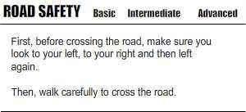
5 Elements of Multimedia
TEXT
GRAPHIC
TEXT
AUDIO
VIDEO
ANIMATION
^{λ} Example

Slide 7
TEXT
Text is the most widely used and flexible means of presenting information on screen and conveying ideas.
Text is an essential aspect of presenting the information.
Like each element of the multimedia design, effective use of text can either direct users/readers attention or divert it.

Slide 8




5 Elements of Multimedia
TEXT
GRAPHIC
GRAPHIC
AUDIO
VIDEO
ANIMATION
Two-dimensional figure or illustration
Could be produced manually (by drawing, painting, carving, etc.) or by computer graphics technology.
Used in multimedia to show more clearly what a particular information is all about (diagrams, picture).

Slide 9
5 Elements of Multimedia
TEXT
GRAPHIC
GRAPHIC
AUDIO
VIDEO
ANIMATION
^{λ} A digital representation of non-text information, such as a drawing, chart, or photograph

Slide 10
GRAPHIC
Pictures(images) is a two-dimensional screen display, and as well as a three-dimensional, such as a statue or hologram.
Graphs, pie-charts, painting etc. all come under images.
Images are a very useful feature of multimedia. Multimedia presentation uses pictures or clip-art to make people understand.
Various file formats of images are .jpg, .png, .gif etc.

Slide 11
5 Elements of Multimedia
TEXT
GRAPHIC
AUDIO
AUDIO
VIDEO
ANIMATION
Produced by vibration, as perceived by the sense of hearing.
In multimedia, audio could come in the form of speech, sound effects and also music score.

Slide 12
AUDIO
Audio refers to sound. Multimedia can include files which contain sounds.
Audio songs also come under the heading multimedia.
Multimedia presentations often have some audio tracks which makes it easier for people to understand.
Multimedia phones have music players to run audio music.
Various audio software include VLC media player, real player, etc.

Slide 13
5 Elements of Multimedia
TEXT
GRAPHIC
ANIMATION
AUDIO
VIDEO
ANIMATION
The illusion of motion created by the consecutive display of images of static elements.
In multimedia, animation is used to further enhance / enriched the experience of the user to further understand the information conveyed to them.

Slide 14

ANIMATION
Animation is the rapid display of a sequence of images of 2-D or 3-D artwork or model positions in order to create an illusion of movement.
The effect is an optical illusion of motion due to the phenomenon of persistence of vision.
Animation adds visual impact to the multimedia project.
Animation are used in cartoons, scientific visualization.

Slide 15
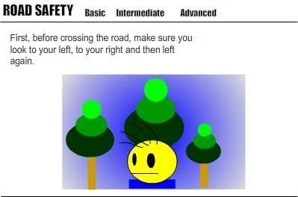
5 Elements of Multimedia
TEXT
GRAPHIC
ANIMATION
AUDIO
VIDEO
ANIMATION
^{λ} Example

Slide 16
5 Elements of Multimedia
TEXT
GRAPHIC
VIDEO
AUDIO
VIDEO
ANIMATION
Is the technology of capturing, recording, processing, transmitting, and reconstructing moving pictures.
Video is more towards photo realistic image sequence / live recording as in comparison to animation.
Video also takes a lot of storage space. So plan carefully before you are going to use it.

Slide 17
VIDEO
A video is unedited material as it had been originally filmed
by movie camera or recorded by a video camera.
The embedding of video in multimedia applications is a powerful way to convey information which can incorporate a personal element which other media lack.
Video enhances, dramatizes, and gives impact to your multimedia application.
The advantage
of integrating video into a multimedia
presentation is the capacity to effectively convey a great deal of information in the least amount of time.

Slide 18
Categorization
Two types of Multimedia presentation
Linear
Presentation
Non-linear
Interactive

Slide 19
Categorization
Linear active content progresses often without any navigational control for the viewer such as a cinema presentation.
Non-linear uses interactivity to control progress as with a video game or self-paced computer based training. Hypermedia is an example of non-linear content.

Slide 20
Linear VS Non-Linear
LINEAR
A Multimedia Project is identified as Linear when:
It is not interactive
User have no control over the content that is being showed to them.
Example:
A movie
A non-interactive lecture / demo show

Slide 21
Linear VS Non-Linear
NON- LINEAR
A Multimedia Project is identified as Non-Linear when:
It is interactive
Users have control over the content that is being showed to them.
Users are given navigational control Example:
Games
Courseware
•

Slide 22
Interactive Multimedia
•
When the user is given the option of controlling the elements.
Hyper Media
^{λ} A combination of hypertext, graphics, audio, video, (linked elements) and interactivity culminating in a complete, non-linear computer-based experience.

Slide 23

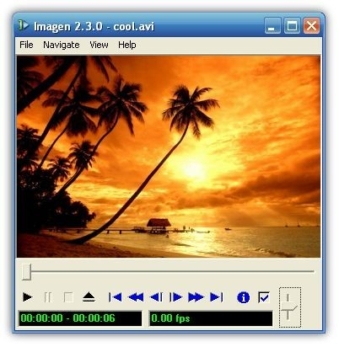




Example
•
Hyper Text and Hyper Media
Main Page Video link Image link Audio Link
1.
2.
3.

Slide 24
Hypermedia
Hypermedia is an updated extension of text in hypertext.
It is the marriage between hypertext and multimedia.
Hypermedia documents contain links to other pieces of text, sound, images, movies, and other forms of media.

Slide 25
Authoring Tools
•
Use to merge multimedia elements (text, audio, graphic, animation, video) into a project.
Designed to manage individual multimedia elements and provide user interaction (if required).
•

Slide 26
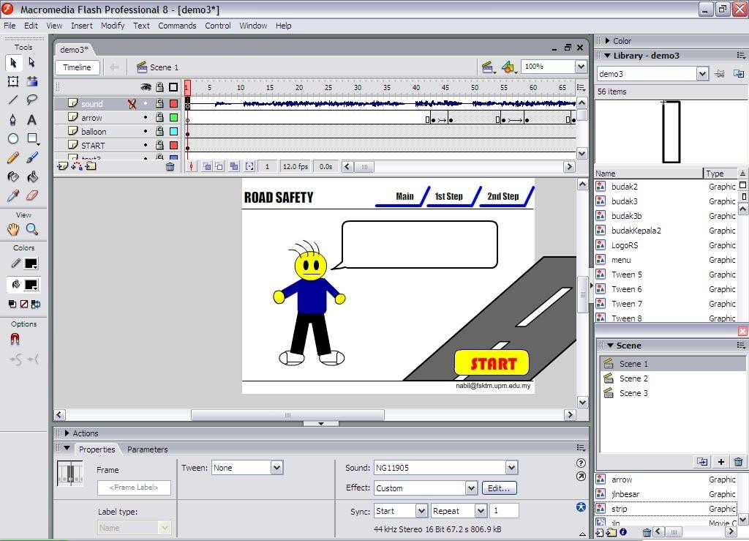
Authoring Tools
Example:
Macromedia Authorware
Macromedia Director
Macromedia Flash
Microsoft Power Point
–
–

Slide 27
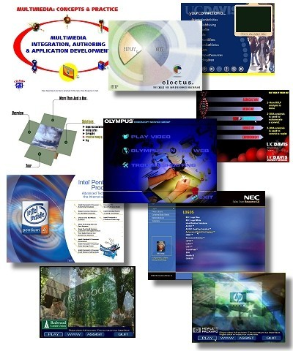
Importance of Multimedia
There are a number of fields where multimedia could be of use. Examples are:-
Business
Education
Entertainment
Home
Public Places

Slide 28
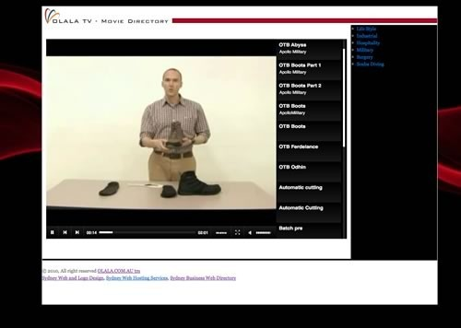
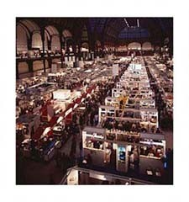
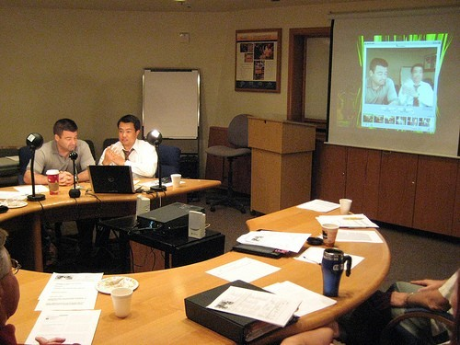

Importance of Multimedia
•
Business
Use and Applications
Sales / Marketing Presentation
Trade show production
Staff Training Application
Company Kiosk

Slide 29
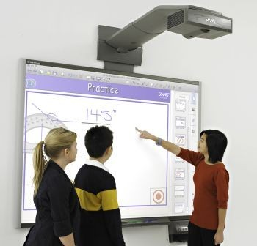
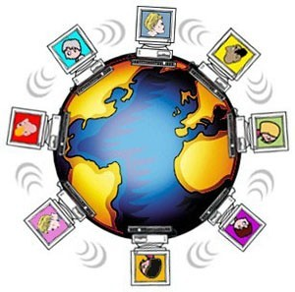

Importance of Multimedia
•
Education
Use and Applications
Courseware / Simulations
E-Learning / Distance Learning
Information Searching

Slide 30
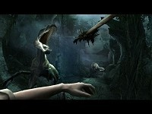
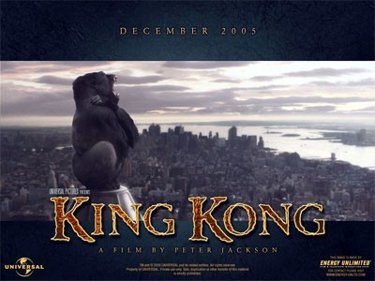
Importance of Multimedia
•
Entertainment
Use and Applications
Games (Leisure / Educational)
Movies
Video on Demand
– Online

Slide 31
Importance of Multimedia
•
Home
Use and Applications
IPTV(internet protocol television)
Satellite TV
Games

Slide 32
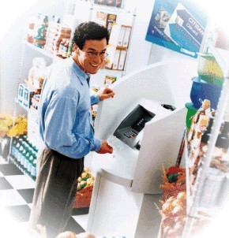
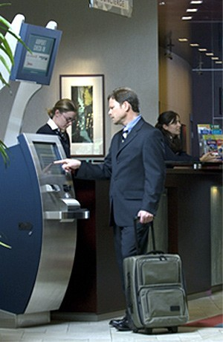
Importance of Multimedia
•
Public Places
Use and Applications
Information Kiosk
Smart Cards

Slide 33
Multimedia Products
Briefing Products
Reference Products
Database Products
Education and Training Products
Kiosk
Entertainment and Games

Slide 34

Multimedia Products
Briefing Products
Small, straightforward, linear products used to present information quickly and concisely.
Characteristic of briefing product:
Short Development Cycle Limited Number of Presentations
Usage of text to present information with limited use of graphic, audio and video.
Have few navigational controls. (mouse click and button press to move from one page to another)
Content and the format are suitable for the audience and fulfill the purpose of the presentation.

Slide 35
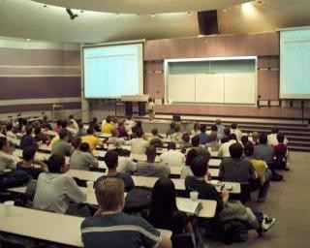
Multimedia Products
Briefing Products
Good briefing presentation depends on:
⎫
⎫
⎫
The understanding of the presented subject. Seamless integration of content.
Reliable layout
Example:
⎫
⎫
⎫
Corporate Presentation Sales Presentation Educational Lectures

Slide 36

Multimedia Products
Reference Products
Often used for answering specific questions or for general browsing of information. (stored on CD/ DVD ROM)
Characteristic of reference product:
⎫
⎫
Used by wide range of user ( young – adult)
Have navigational menu, book marking, searching, printing utility
2 Basic classes of reference product:
⎫
Generalized Content (dictionary/encyclopedia)
Broad treatment of content at a limited depth
⎫
Detailed Content
Focus on specific area and provide extensive information.

Slide 37
Multimedia Products
Reference Products
Good usability and success depends on:
The developers understanding the body of information and how the end user will want to access it.
Help function should always available to explain how to access and use the information
⎫
⎫
Examples are electronic forms of:
⎫
⎫
⎫
⎫
Encyclopedia Dictionaries
Cookbooks, Historical, Informative Scientific surveys.

Slide 38
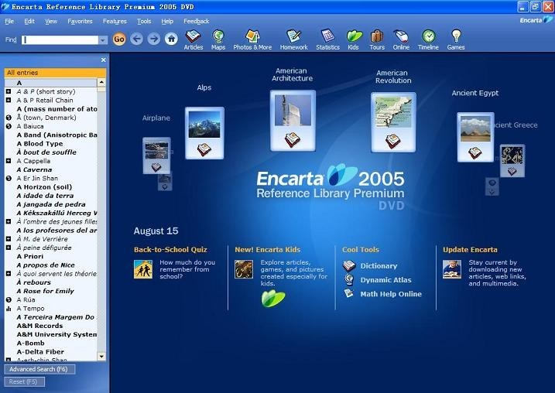
Multimedia Products
Reference Products
Example:

Slide 39

Multimedia Products
Database Products
Similar to reference product in a sense that large amount of information are made available to the end user.
Focus on storing and accessing the actual data (multimedia data such as text, graphic, audio, animation and video)
Characteristics of Database Products are:
⎫
⎫
Manages multimedia data (large data) Descriptive finding methods
♣
Content based search
⎫
Simultaneous access
♣
Online database
⎫
Relational consistency in data management.

Slide 40
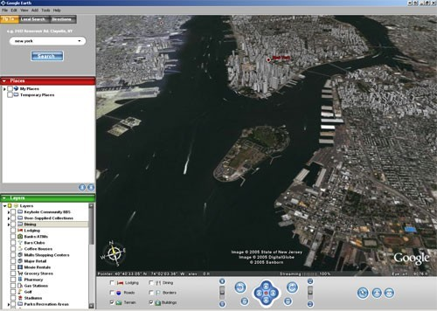
Multimedia Products
Database Products
Examples are:
⎫
⎫
Google Search Google Earth

Slide 41

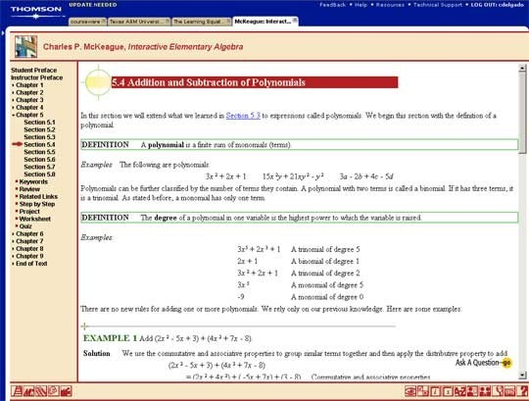
Multimedia Products
Education and Training Products
Similar to textbook or training manuals but have added media such as audio, animation and video.
Make up a significant share of the multimedia market ranging from pre- kindergarten to postgraduate offerings from technical to corporate training products.
2 categories of reference product:
•
⎫
⎫
⎫
Instructor Support Products Standalone or Self-Paced Products Combination Products
Shares the same characteristics as Reference Product

Slide 42

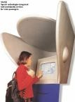
Multimedia Products
Kiosk Products
A product which is usually stationed at public places and allow the user to find information interactively and also other types of transaction.
Characteristics of Kiosk Products:-
⎫
⎫
⎫
Limited target users and usage.
User friendly and easily used by user. Fast response.

Slide 43

Multimedia Products
Kiosk Products
Categories of Kiosk
⎫
Point Of Information
θ
Provide certain information (example map, timetable etc)
⎫
Point Of Sales System
θ
Allow users to purchase or make orders
⎫
⎫
⎫

Slide 44

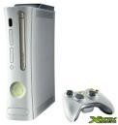

Multimedia Products
Entertainment & Games
Most popular
Shipped in the form of Interactive means.
Characteristics of E & G Products:-
Requires constant feedback and interaction with the user. Challenging and sometimes interesting for user
Enabled online play for more than one user experience.

Slide 45
INTERACTIVITY
Interactivity can be termed as the dialog that occurs between an individual and a computer program.
Interactive multimedia refers to the multimedia applications that allow users to actively participate rather than being passive recipients of information.
Technologies such as DVDs and digital TV are classic examples of interactive media devices, where a user can control what they watch and when.

Slide 46
CONTD..
Interactivity also relates to new media art technologies where humans and animals are able to interact with and change the course of an artwork

Slide 47
MULTIMEDIA TODAY
Multimedia and its related applications have almost become synonymous with modern technology; given the kind of explosion the technological realm has seem.
Multimedia makes our life easier several times fold. It is through multimedia that mobile phones can be used for a number of purposes.

Slide 48
Multimedia today
With the introduction of newer generation of mobile phones and more advanced communication protocols, the number of multimedia uses that your phone can be put to keeps growing.
Video conferencing which enables people across global borders to communicate with each other in real time is an excellent example of how multimedia has benefited the world of communications and telephony.

Slide 49
SCOPE OF MULTIMEDIA
The technology of multimedia design utilizes various features like animation, video, graphics, audio and sound to impress the users.
Multimedia technology is used for 3D cinema applications and mobile 3DTV environments.
Animation is also being used in titling films, creating special effects or in web entertainment programs. Thus scope of animation is huge in context to market.

Slide 50
In the field of education multimedia is being used extensively especially for online courses and trainings.
Multimedia is also used in advertising purposes.

Slide 51
ADVANTAGES
Multimedia enhances the effect of text presentations.
Improves the quality of presentation and retains the attention of audience.
It can be used for educational as well as entertainment purpose.
It is quick and easier to operate for the instructor.
Multimedia presentations can be modified very easily.
Multimedia is Entertaining as Well as Educational.

Slide 52
Dis-advantages:-
Non-interactive – if one-way, no feedback.
Complex to create.
Time consuming.
Use of multimedia is expensive.

